Slide 1
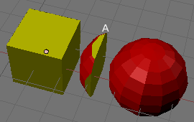
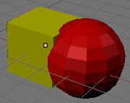
Solid Modeling

Slide 2
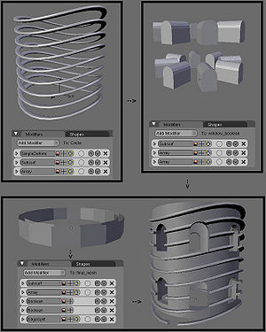
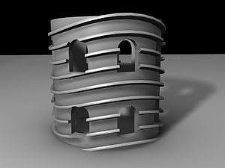
Solid Modeling

Slide 3
Solid Modeling
interior
exterior

Slide 4
Solid Modeling;
Lines and curves don’t need to describe boundary of closed area
In many applications it is necessary to distinguish between the inside, out side and surface of 3D objects.
e.g. satisfactory representation of solid object makes it possible to generate instructions automatically for the computer controlled machine tools to create that object.
Need to model objects as solids has resulted in development of many ways to represent them.
Basics of solid modeling theory
Geometry , topology,
(x,y,z) coordinates of vertices : geometry
Connectivity matrix: topology
geometric closure,

Slide 5
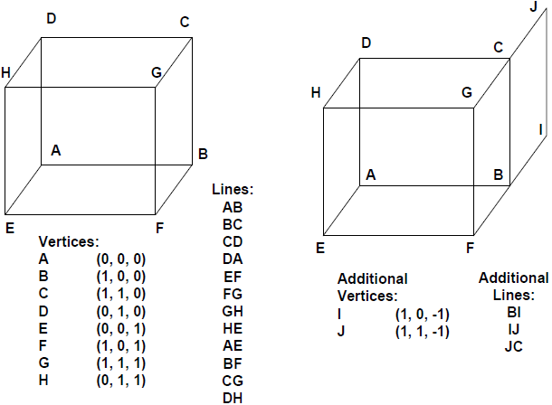
Representing Solid:
We use lines, polygons, curves to represent objects
Lines in figure define a solid cube if each set of 4 lines on each side of object is assumed to bound a square face then the figure is a cube.
If we add extra lines to it then we would end up with all faces of figure plus an extra dangling face producing object that doesn’t bound a volume.
So extra constraints are required to ensure that representation of this sort models only solids.

Slide 6
Representing solid:
Domain: domain of representation should be large enough to allow useful set of physical objects to be represented.
Unambiguous: no questions regarding what is being represented. A given representation should correspond to one and only one solid.
Unique: if it can be used to encode any given solid in only one way.
Accuracy: accurate representation allow object to be represented without approximation.
Compact: compact to save space
Efficient: efficient algorithms for computing desired physical properties.
A representation scheme should make it impossible to create an invalid representation(one that doesn’t correspond to a solid )
Maintain closure under rotation, translation, etc. Which means that performing these operations on valid solids should yield only valid solids!!

Slide 7
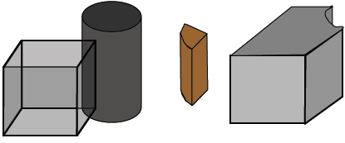
i. Regularized Boolean set operations:
We want to be able to combine objects to make new ones
Boolean operations U , Π , - etc could be used but applying ordinary
Boolean set operations to two solid objects doesn’t yield a solid object.
So we use regularized Boolean set operations denoted by U , Π , - defined such that operations on solids yield only solids.

Slide 8
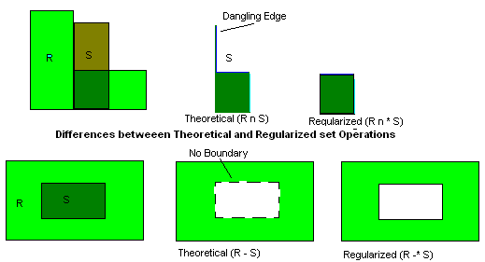
i. Regularized Boolean set operations:

Slide 9
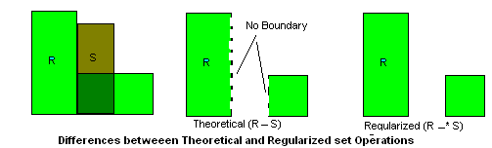
i. Regularized Boolean set operations:

Slide 10
i.Regularized Boolean set operations:
Boundary points are those points whose distance from object and objects complement is zero.
A closed set contains all its boundary points where as open set contains none.
Union of a set with set of boundary points is called its closure.
Boundary of closed set is a set of its boundary points.
Interior is complement of boundary with respect to the object.
Regularization is defined as closure of sets interior points.
Regular set can contain no boundary points, that is not adjacent to some interior point thus it can have no “dangling” boundary points, lines, surface.
A op* B = closure(interior(A op B)) where op is U , Π , -

Slide 11
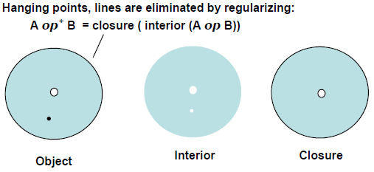
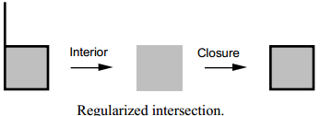
i.Regularized Boolean set operations:

Slide 12
ii. Constructive Solid geometry (CSG)
Assumption:
Physical objects are created by combining basic elementary shapes (blocks , cylinders, cones , spheres)thru specific rules
Boolean operations , union, difference, intersection are used to combine the regularized sets formed by primitives
Binary tree structure is used as data structure for the CSG representation
CSG tree is a binary tree with leaf nodes as primitives and interior nodes as boolean operations

Slide 13
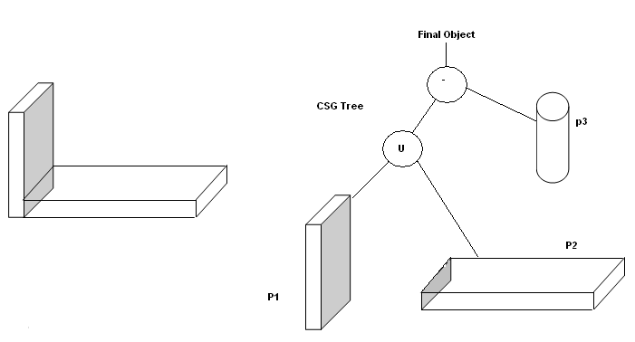
ii. Constructive Solid geometry (CSG)

Slide 14
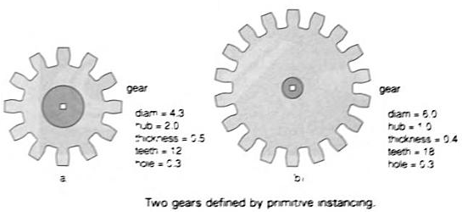
iii.Primitive Instancing
Defines a set of primitive 3D solid shapes that are relevant to application area
e.g. a primitive object may be regular pyramid with user defined number of faces meeting at Apex.
Parametric primitive defines a family of parts whose members vary in a few parameters, known as group technology in CAD.
Used for modeling complex objects gears, bolts.
Gears may be parameterized by its diameter, number of tooth etc.

Slide 15
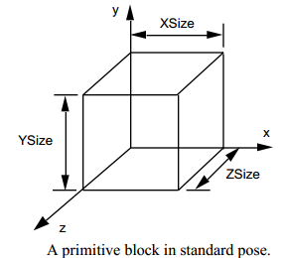
iii.Primitive Instancing
Here, there’s no provision are made for combining objects to form a new higher level object so only way to create a new kind of object is to write code that defines it.
Every scheme has primitives, which must be instantiated to construct structured
representations. Primitives may be low level, e.g. the points used to represent polygons
A primitive is a parameterized geometric entity, typically represented by a tuple containing a type code (e.g. a string ‘point’ o r ‘block’) followed by several real numbers that correspond to specific parameter values. For example, a solid block aligned with the principal axes can be represented by the 4-tuple
(‘block’, XSize, YSize, ZSize)

Slide 16
iv.Sweep Representation
Sweeping an object along trajectory thru space defines new object called sweep.
A set of two dimensional primitives e.g. circles, rectangles can be provided as menu options.
Translational sweep:
Spline (periodic) defines object cross section
Perform translational sweep by moving control points P₀ thru P₃ along a straight line path
perpendicular to plane of cross section.
At intervals along this path we replicate the cross sectional shape and draw a set of connecting lines in the direction of the sweep to obtain the desired representation.
Rotational sweep:
Spline cross section is rotated about an axis of rotation specified in plane of
cross section to produce the representation
Any axis can be chosen for rotational sweep.

Slide 17
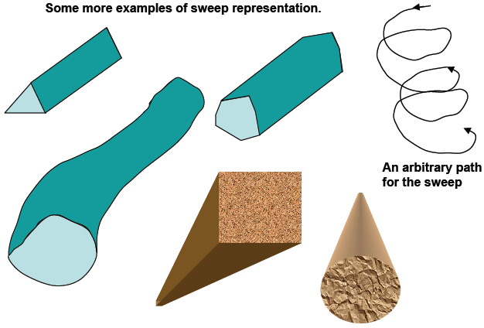
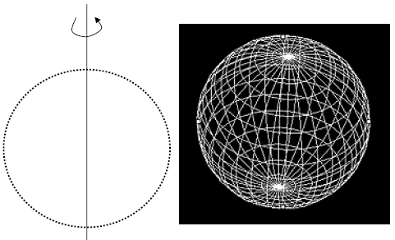
iv.Sweep Representation

Slide 18
B-reps (Boundary Representations)
Object is defined in terms of its surface boundaries, vertices, edges and faces. Curved surfaces are always approximated with polygons –piecewise linear/planar.
Use planar, polygonal boundaries, but may also use convex polygons or triangles.
Euler’s formula:
Let V be the number of vertices, E the number of edges, and F the number of faces of a simple polyhedron. Then
V –E + F = 2

Slide 19
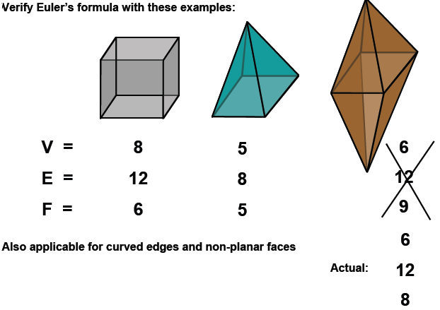
B-reps (Boundary Representations)

